Slide 1
EE 521/ECE 582 – Analysis of Power systems
Class #11 – September 29, 2022
Dr. Noel N. Schulz
Edmund O. Schweitzer III Chair in
Power Apparatus and Systems
Chief Scientist Joint Appointment, PNNL
Co-Director, PNNL/WSU Advanced Grid Institute (AGI)
Washington State University Pullman
Noel.Schulz@wsu.edu EME 35
509-335-0980 (o) and 509-336-5522 (c)

Slide 2
Reminders
Student Hours This Week & Next
Friday 1:30-2:30 pm Zoom or EME 35 Pullman
Tuesday 4:30-5:30 pm (after class) – Zoom or EME 35 Pullman
Wednesday 4-5 pm Zoom or EME 35 Pullman
Friday 1:30-2:30 pm Zoom or EME 35 Pullman
Remember the Discussion Set Assignment
9/30 Summary, 10/4 Questions, 10/11 Discussions
Final Paper – Think about Topic - Oct 14
Video posted on IEEE Xplore Search

Slide 3
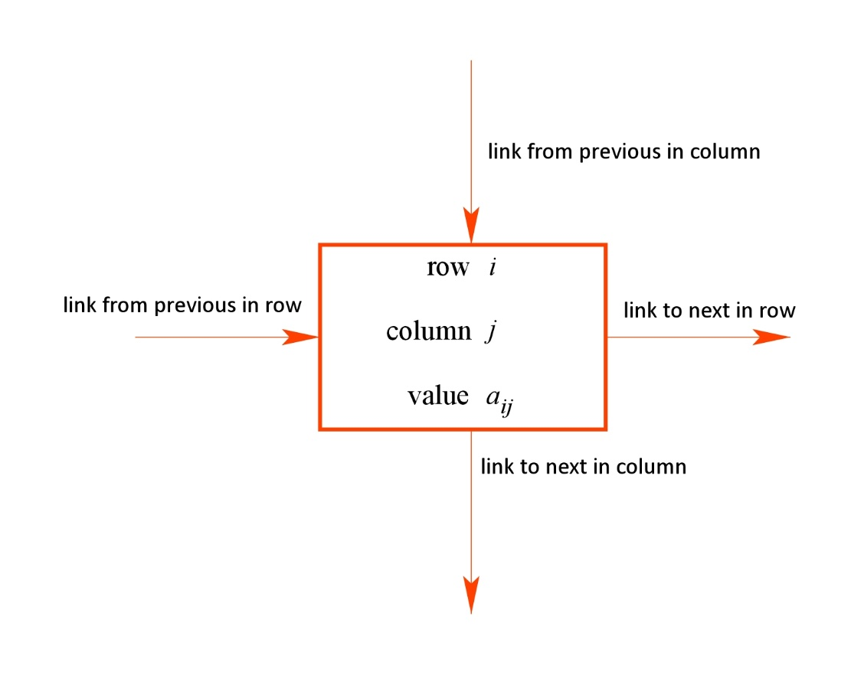
Sparse Storage
Each element in a matrix has a variety of information associated with it that distinctly identify it.
The basic information is:
Row number (integer)
Column number (integer)
Value (real)
However, to place it within the matrix in which only non-zeros are stored, a linked list approach is used.
Thus, the links connecting it within each row and column must also be specified.

Slide 4
Example: Visualize the matrix A as a linked list:
This matrix has 12 non-zero elements. The order of each element can be random.
6
Row | 3
Column | 3
Value | 3
5
Row | 2
Column | 4
Value | 1
12
Row | 5
Column | 5
Value | -4
2
Row | 1
Column | 3
Value | -2
1
Row | 1
Column | 1
Value | -1
8
Row | 4
Column | 2
Value | -3
11
Row | 5
Column | 2
Value | 2
4
Row | 2
Column | 2
Value | 8
3
Row | 2
Column | 1
Value | 2
7
Row | 3
Column | 5
Value | -2
10
Row | 5
Column | 1
Value | 1
9
Row | 4
Column | 3
Value | 2

Slide 5
First in Row and First in Column
6
Row | 3
Column | 3
Value | 3
5
Row | 2
Column | 4
Value | 1
12
Row | 5
Column | 5
Value | -4
2
Row | 1
Column | 3
Value | -2
1
Row | 1
Column | 1
Value | -1
8
Row | 4
Column | 2
Value | -3
11
Row | 5
Column | 2
Value | 2
4
Row | 2
Column | 2
Value | 8
3
Row | 2
Column | 1
Value | 2
7
Row | 3
Column | 5
Value | -2
10
Row | 5
Column | 1
Value | 1
9
Row | 4
Column | 3
Value | 2

Slide 6
Next in Row
Correct
6
Row | 3
Column | 3
Value | 3
5
Row | 2
Column | 4
Value | 1
12
Row | 5
Column | 5
Value | -4
∅
∅
2
Row | 1
Column | 3
Value | -2
∅
1
Row | 1
Column | 1
Value | -1
8
Row | 4
Column | 2
Value | -3
11
Row | 5
Column | 2
Value | 2
4
Row | 2
Column | 2
Value | 8
3
Row | 2
Column | 1
Value | 2
7
Row | 3
Column | 5
Value | -2
10
Row | 5
Column | 1
Value | 1
9
Row | 4
Column | 3
Value | 2
∅
∅

Slide 7
Updated
3
10
0
8
11
0
6
9
0
0
12
0
Next in Column
NIC=
6
Row | 3
Column | 3
Value | 3
5
Row | 2
Column | 4
Value | 1
12
Row | 5
Column | 5
Value | -4
2
Row | 1
Column | 3
Value | -2
1
Row | 1
Column | 1
Value | -1
∅
8
Row | 4
Column | 2
Value | -3
∅
11
Row | 5
Column | 2
Value | 2
4
Row | 2
Column | 2
Value | 8
3
Row | 2
Column | 1
Value | 2
∅
7
Row | 3
Column | 5
Value | -2
10
Row | 5
Column | 1
Value | 1
9
Row | 4
Column | 3
Value | 2
∅
∅
Also wrong on page 122 in book

Slide 8
Insert A(4,5)=10 into the sparse storage structure
Make new element
Update NROW, NCOL, and Value vectors
Update NIR and NIC vectors
(13)
13
Row | 4
Column | 5
Value | 10
6
Row | 3
Column | 3
Value | 3
5
Row | 2
Column | 4
Value | 1
12
Row | 5
Column | 5
Value | -4
2
Row | 1
Column | 3
Value | -2
1
Row | 1
Column | 1
Value | -1
8
Row | 4
Column | 2
Value | -3
11
Row | 5
Column | 2
Value | 2
4
Row | 2
Column | 2
Value | 8
3
Row | 2
Column | 1
Value | 2
7
Row | 3
Column | 5
Value | -2
2
0
4
5
0
7
0
9
0
11
12
0
2
0
4
5
0
7
0
9
13
0
11
12
0
3
10
0
8
11
0
6
9
0
0
12
0
3
10
0
8
11
0
6
9
0
0
13
12
0
10
Row | 5
Column | 1
Value | 1
9
Row | 4
Column | 3
Value | 2
NIR=
NIC=

Slide 9
Graph Representation of a Matrix
Each node is vertex
Each non-zero element is an edge
1
8
2
5
7
6
10
9
3
4

Slide 10
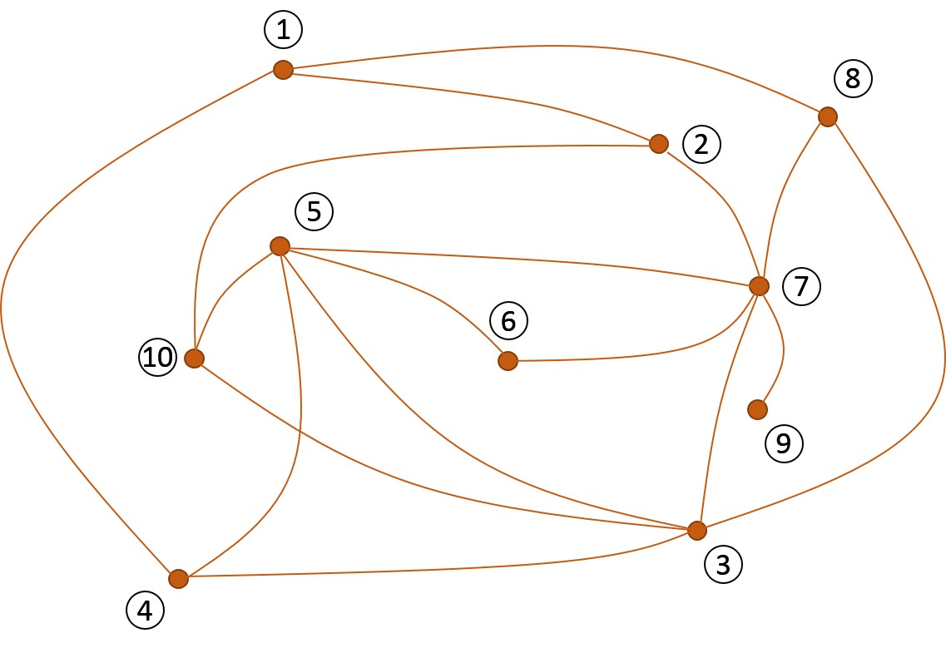
Sparse Matrix Structure
A “dot” for every non-zero entry
analogous

Slide 11
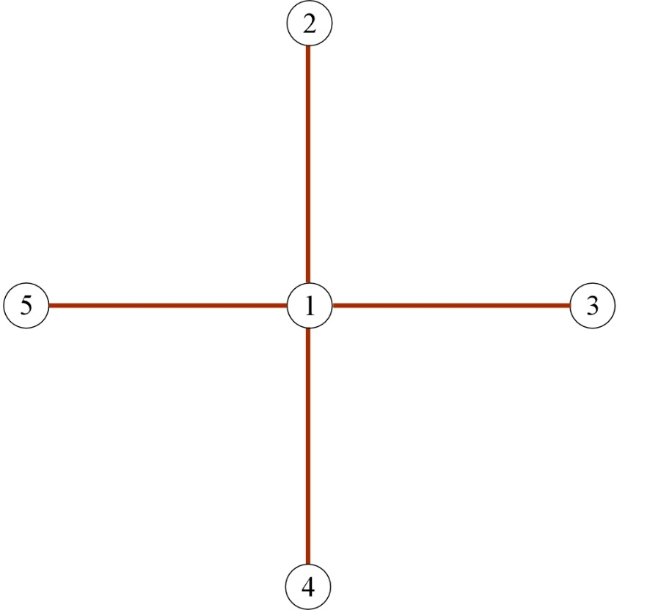
Ordering Schemes
The order in which the matrix nodes are numbered can have a significant impact on the amount of computation required solve Ax=b by LU factorization.
Matrix structure
Find Q and the number of multiplications and divisions required
graph

Slide 12
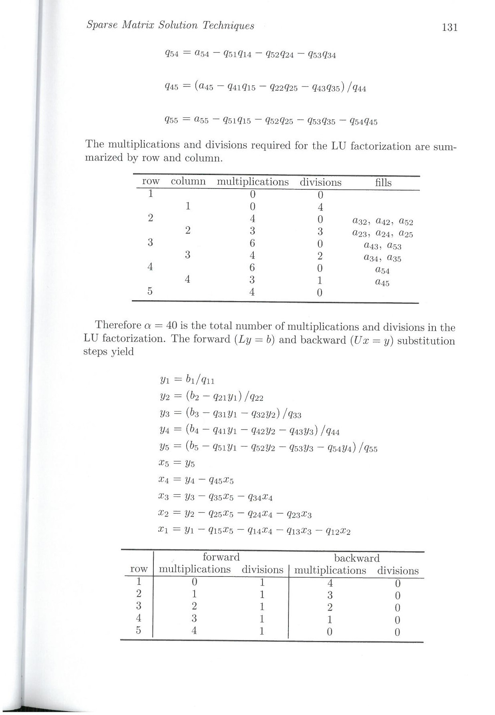
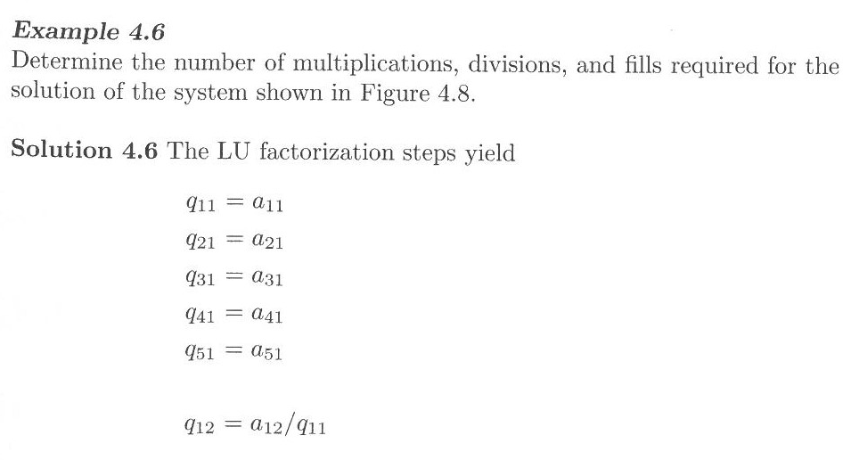
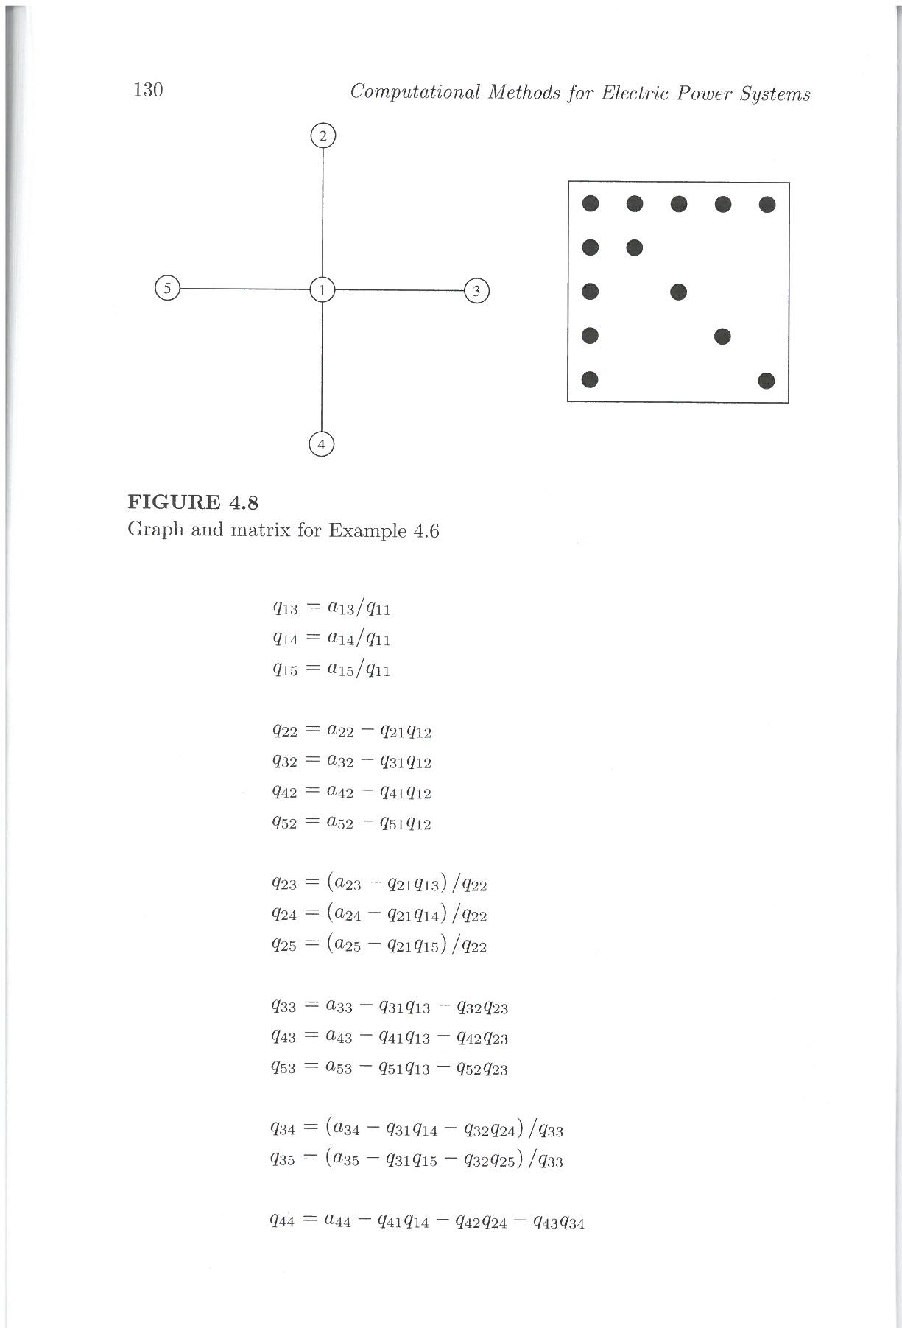
LU Factorization
 | Multiplications | Divisions
First column
First row
Second column
Second row
Third column
Third row
Fourth column
Fourth row
Fifth column
0
0
0
4
4
0
3
3
Total = α = 40
6
0
4
2
Fills = 12
6
0
3
1
4
0

Slide 13
Forward and Backward Substitution
 | Multiplications | Divisions
First row
Second row
Third row
Fourth row
Fifth row
0
1
1
1
2
1
3
1
4
1
 | Multiplications | Divisions
First row
Second row
Third row
Fourth row
Fifth row
4
0
3
0
2
0
1
0
0
0
Total = β = 25
α + β = 65

Slide 14
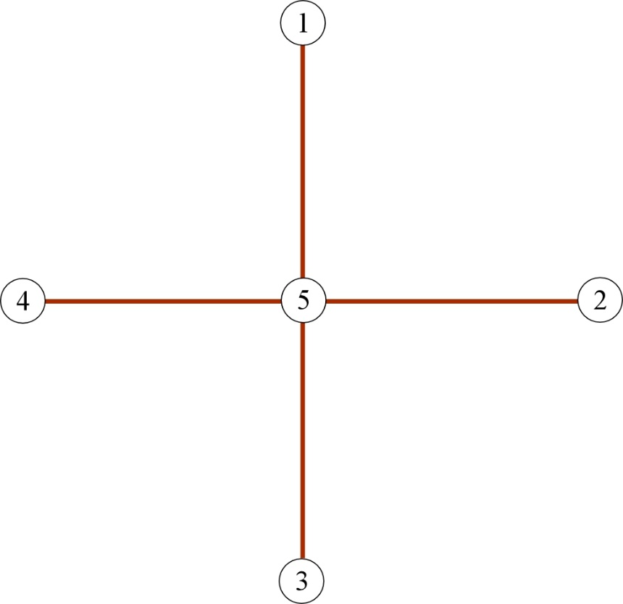
Matrix Reordered:
Matrix structure
Find Q and the number of multiplications and divisions required
graph

Slide 15
Follow example in book for this one
Page 132-135
LU Factorization
 | Multiplications | Divisions
First column
First row
Second column
Second row
Third column
Third row
Fourth column
Fourth row
Fifth column
0
0
0
1
0
0
0
1
0
0
0
1
0
0
0
1
4
0
Total = α = 8
Fills = 0

Slide 16
Forward and Backward Substitution
 | Multiplications | Divisions
First row
Second row
Third row
Fourth row
Fifth row
0
1
0
1
0
1
0
1
4
1
 | Multiplications | Divisions
First row
Second row
Third row
Fourth row
Fifth row
1
0
1
0
1
0
1
0
0
0
Total = β = 13
α + β = 21

Slide 17
What made the difference?
The number of Fills!
A fill occurs when a matrix element that was originally zero becomes nonzero
during the factorization process.
5
Node 1 is factorized first (removed from graph)
Edges are added joining nodes to which node 1 was connected
4
1
2
(3-2)
(4-2)
(5-2)
(4-3)
3
(5-3)
(5-4)
12 Fills

Slide 18
Node
Fills
9
7
1
6
8
3
4
5
2
Find fills, α, and β
10
1
8
2
5
7
6
10
9
3
4

Slide 19
3
4
5
4
4
3
3
Number of non-zeros
4
2
1
5
6
5
5
4
4
3
2

Slide 20
This has fewer fills than this
We want a node ordering that produces the fewest fills.
It will have a “lower facing arrow” structure

Slide 21
Scheme 0
Calculate the degree of all vertices.
Choose the node with the lowest degree. Place in ordering scheme.
In case of a tie, choose node with lowest natural ordering.
Return to step 2.

Slide 22
Reorder using Scheme 0, find fills, α, and β
1
2
3
4
5
6
7
8
9
10
Node | degrees
1 | 3
2 | 3
3 | 5
4 | 3
5 | 5
6 | 2
7 | 6
8 | 3
9 | 1
10 | 3
New Order
9 | 6 | 1 | 2 | 4 | 8 | 10 | 3 | 5 | 7

Slide 23
New Order
Find Fills
9
6
1
2
4
8
10
3
5
7

Slide 24
Scheme 1
Calculate the degree of all vertices.
Choose the node with the lowest degree. Place in ordering scheme. Eliminate it and update degrees accordingly.
In case of a tie, choose node with lowest natural ordering.
Return to step 1.

Slide 25
Reorder using Scheme 1, find fills, α, and β
1
Node | degrees
1 | 3
2 | 3
3 | 5
4 | 3
5 | 5
6 | 2
7 | 6
8 | 3
9 | 1
10 | 3
8
5
4
4
2
4
3
5
4
4
7
2
6
10
1
4
2
5
3
4
1
3
2
9
3
4
New Order
9
6
1
10
4
2
3
5
7
8

Slide 26
Find Fills
9
6
1
10
4
2
3
5
7
8

Slide 27
Scheme 0 (minimum-degree) has the advantage of being easily implemented with improved results over non-ordering
Scheme 1 still relies on the minimum-degree approach, but it includes a simulation of the LU factorization process to update the node degrees at each step of the factorization (minimize α)
Scheme 2 endeavors to minimize the number of fills at each step of the factorization (minimize α and β).

Slide 28
Scheme 2
For each node, calculate the number of fills that would result from its elimination.
Choose the node with the lowest number of fills.
In case of a tie, choose node with lowest degree.
In case of a tie, choose node with lowest natural ordering.
Place node in ordering scheme. Eliminate it and update fills and degrees accordingly.
Return to step 1.

Slide 29
Reorder using Scheme 2, find fills, α, and β
Node | degrees | fills created
1 | 3
2 | 3
3 | 5
4 | 3
5 | 5
6 | 2
7 | 6
8 | 3
9 | 1
10 | 3
4
2-4, 2-8, 4-8
1
2-3, 2-5, 2-8, 5-8
8
1-7, 1-10, 7-10
1-7, 1-10, 5-8
7-10, 8-10
4-7, 4-8, 4-10
5-8, 7-10, 8-10
2
5
1-3, 1-5
4
3-6, 4-6, 4-7
4-10, 6-10, 7-10
1-7, 1-10, 7-10
7
4-7, 4-10, 7-10
6
none
10
2-3, 2-5, 2-6,
2-8, 2-9, 3-6, 3-9, 5-8, 5-9, 6-8, 6-9, 8-9
2-3, 2-5,
2-8, 5-8
4
2-3, 2-5, 2-6,
2-8, 3-6, 5-8, 6-8
5
9
1-7
1-3, 1-7
3
none
4
New Order
2-3, 2-5
9
6
4

Slide 30
Reorder using Scheme 1, find fills, α, and β
Node | degrees | fills created
1 | 3
2 | 3
3 | 5
4 | 3
5 | 5
6 | 2
7 | 6
8 | 3
9 | 1
10 | 3
none
4
2-4, 2-8, 4-8
2-3, 2-5, 2-8, 5-8
2-3, 2-5
1
1-7, 1-10, 7-10
1-10, 7-10
8
1-7, 1-10, 5-8
7-10, 8-10
4-7, 4-8, 4-10
5-8, 7-10, 8-10
none
4
1-10, 7-10
3
2
1-3, 1-5
5
3-6, 4-6, 4-7
4-10, 6-10, 7-10
4
1-7, 1-10, 7-10
2
4-7, 4-10, 7-10
3
1-10, 7-10
none
7
none
10
2-3, 2-5, 2-6,
2-8, 2-9, 3-6, 3-9, 5-8, 5-9, 6-8, 6-9, 8-9
3
2-3, 2-5,
2-8, 5-8
2
4
none
1
5
2-3, 2-5
1-7
1-3, 1-7
none
3
none
4
2-3, 2-5
1
3
2
New Order
9
6
4
8
2
1
3
5
7
10

Slide 31
Node | degrees | fills created
1
2 |  | 1-10, 7-10
3
4 |  | 1-3, 3-5
5
6
7
8 |  | 1-7
9
10
9
6
4
8
2
1
3
5
7
10

Slide 32
Scheme | α | β | α + β
No ordering | 134 | 68 | 202
Scheme 0 | 110 | 60 | 170
Scheme 1 | 92 | 56 | 148
Scheme 2 | 84 | 54 | 138
Scheme 0
9 | 6 | 1 | 2 | 4 | 8 | 10 | 3 | 5 | 7
Scheme 1
9
6
1
10
4
2
3
5
7
8
Scheme 2
9
6
4
8
2
1
3
5
7
10

Slide 33
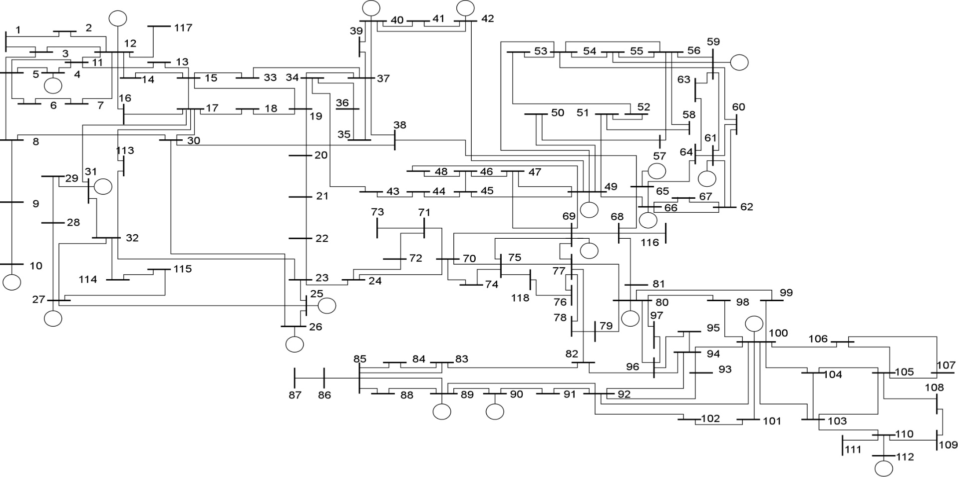
Power System Applications

Slide 34
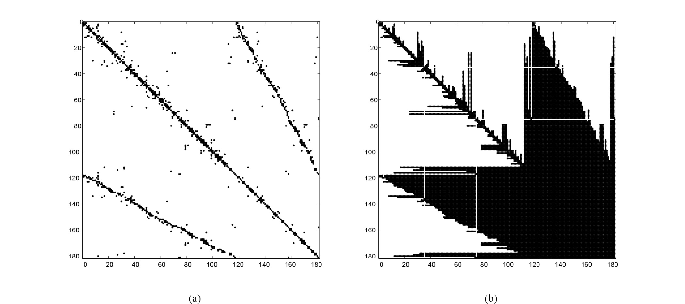
No Ordering

Slide 35
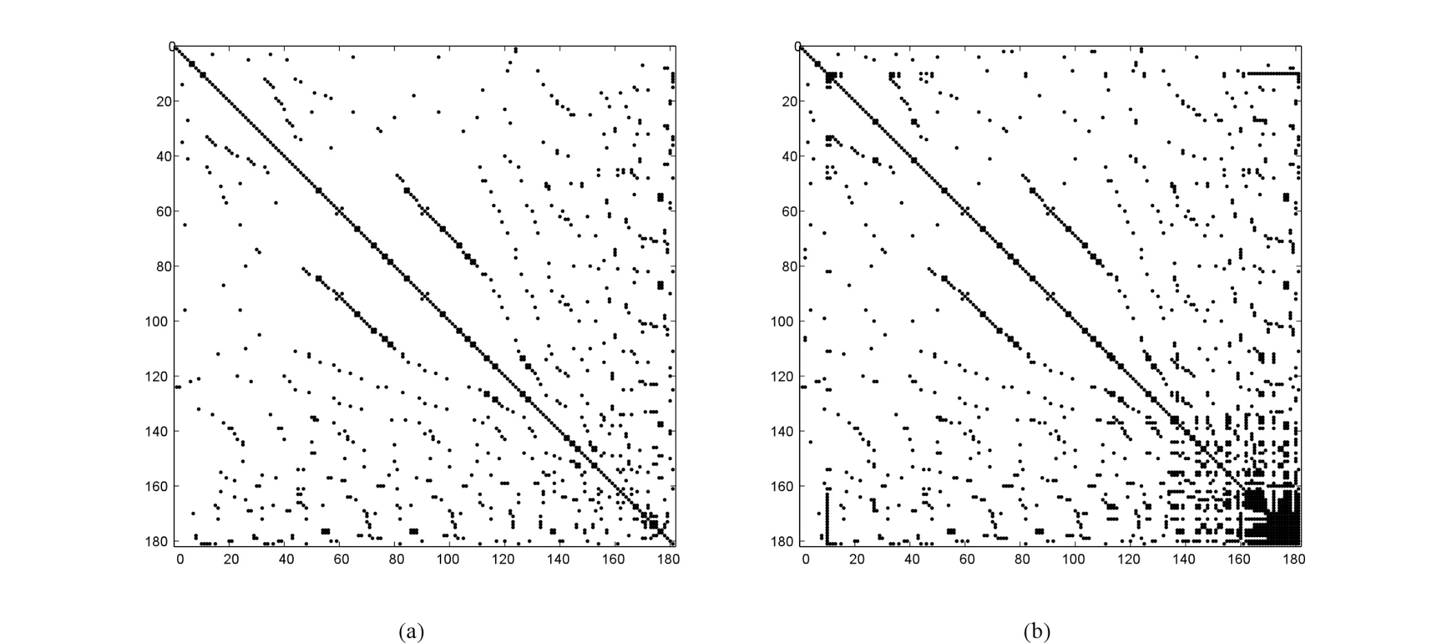
Scheme 0

Slide 36
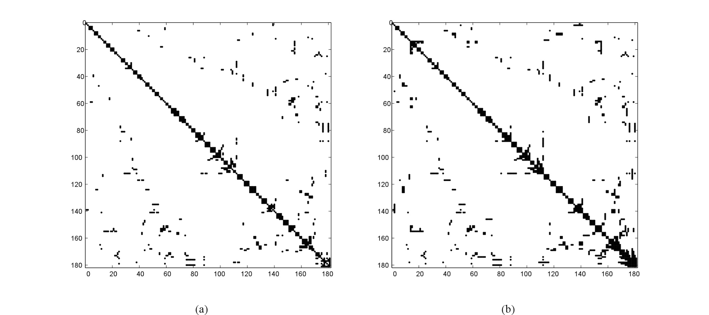
Scheme 1

Slide 37
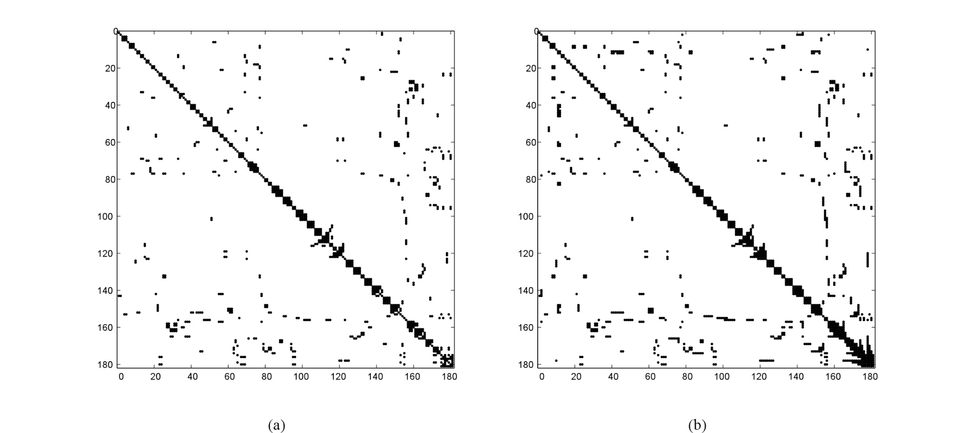
Scheme 2

Slide 38
Program #2 Sparse Matrix NR Power Flow
Input Data
Calculate Jacobian Terms
with taps
L-U Factorization
Calculate Y_{bus}
Solve Equation [A][x] = [b]
Backward/ Forward Substitution
Calculate Jacobian Terms
Calculate Mismatch]
_{Iterative Solution}
Check Mismatch?
What changes in your code?
Small = enough
Output Results
Output Results

Slide 39
Program #2 Sparse Matrix NR Power Flow
Input Data
with taps
Calculate Y_{bus}

Slide 40
Program #2 Sparse Matrix NR Power Flow
Calculate Jacobian Terms

Slide 41
Program #2 Sparse Matrix NR Power Flow
L-U Factorization
Backward/ Forward Substitution

Slide 42
Program #2 Sparse Matrix NR Power Flow
Input Data
Calculate Jacobian Terms
with taps
L-U Factorization
Calculate Y_{bus}
Solve Equation [A][x] = [b]
Backward/ Forward Substitution
Calculate Jacobian Terms
Calculate Mismatch]
_{Iterative Solution}
Check Mismatch?
Small = enough
Output Results
Output Results

Slide 43
Program #2 Sparse Matrix NR Power Flow

Slide 44
Announcements
Chapter 4
Read Papers for Discussion Set
Work on Program #1

